Slide 1
Architectural Home Plan Designing System with Knowledge Base Inspection
Research Methodology
R.P.M.C.Rajapaksha
2298
ICT/08/09/018

Slide 2
Main Research Question
How to define a logical definition for a house according to the architectural, legal, geometrical and scaling rules.

Slide 3

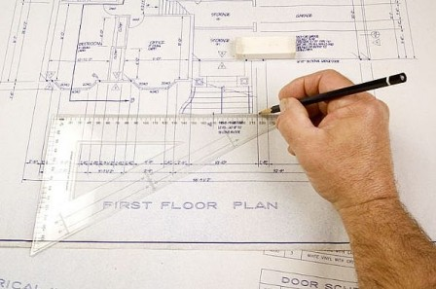
Research Methodology
Step 1 : Familiarization
Watching or talking to architects
Literature review
Record the knowledge clearly

Slide 4
Literature Review Algorithmic Approaches
Quadratic Assignment System
The earliest research in automated design generation built upon optimization work conducted in operations research.
Advantages
Introduced an evaluation component
Rather than focusing exclusively on the synthesis of configurations, opportunity to evaluate solutions based on a defined set of criteria.
Disadvantages
Failure to address the multiple attribute issue.
Ignore the complex attribute inter relationships.

Slide 5
Algorithmic Approaches (cont)
2. Graph Theory
Researchers documented the potential for portraying relationships as links within a graph representation.
Advantages
Addresses the expandable theory issue
Addresses two further design generation issues: multiple attributes and multiple stages
Disadvantages
limitation in their recognition of non-adjacency
based issues such as design concepts and
economic viability.

Slide 6
Algorithmic Approaches (cont)
3. Rectangular Dissections
Divide rectangular regions into smaller rectangles
Initially a relationship graph is generated based on an adjacency relationship matrix.
The algorithm then randomly selects one node from the graph as the first space to generate.
After that the rectangle is dissected into two sections, the first contains the area required for the first node, and the second contains the remaining area required for the configuration.
The remaining area is then dissected into two sections and this process continues until all required spaces have been allocated.

Slide 7
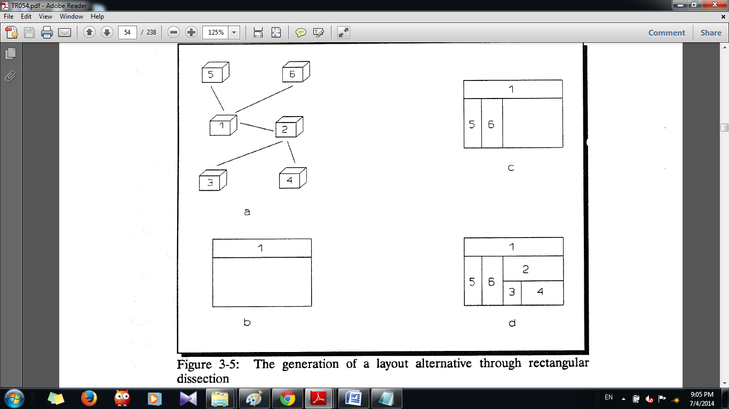
Algorithmic Approaches (cont)
3. Rectangular Dissections (cont)
Advantages
Different relationship graph nodes permits the methodology to create a number of design alternatives from a single set of relationships.
Disadvantages
Eliminates designer participation
Reduces the system capacity to provide design assistance based on user initiated requests.

Slide 8
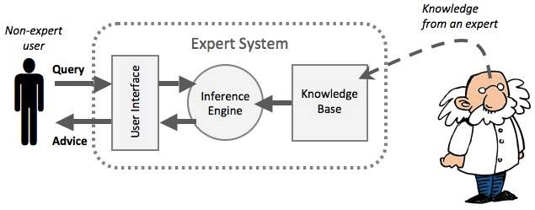
My Approach
Knowledge base paradigm
Capability to focus on design process reasoning.
Specifically knowledge-based systems can be used to capture the rules of thumb or heuristics or designers utilize throughput the layout conceptualization process.

Slide 9
Proposed System Architecture
Design Generator
Design generation knowledge source
Knowledge Model
Controller
Four components
Design generator
Knowledge model
Topological Attributes
Design Attributes
Design generation
knowledge sources
IV. Controller.

Slide 10
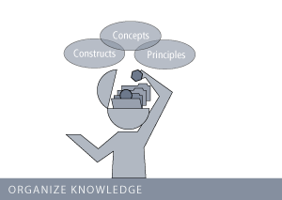
Research Methodology (cont)
Step 2 : Organizing Knowledge
Capture the regularities
Build a grammar to express the facts and rules
Eg: rule ::= IF (observation) THEN (conclusion) A space should have minimum 100 Sq Feet and it should be in south east or north west to be a kitchen.

Slide 11
Geometric Rules Finalized
House plan should be a set of inter connected polygons.
There should be a common set of lines in the adjacency connected polygons.
There should be a minimum area for each polygon.
Each polygon should have the ability to be visited by other polygon.
No windows inside the walls.
Doors and windows should be in only walls.

Slide 12
Research Methodology (cont)
Step 3 : Representing Knowledge
Represent the knowledge in an expert system
According the target inference engine define the syntaxes for the rules
Eg: bed_room(area,direction) :- min_area(bed_room, area), direction(bed_room,direction)

Slide 13
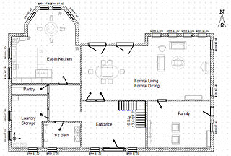
Research Methodology (cont)
Step 4 : Prototype Implementation
Implement the knowledge base.
Interfaces to abstract the customer requirements.
Visualize the final out put.
Modify the prototype.

Slide 14
Proof of Concept
Development of the system
Define a proper mechanism to abstract the customer requirements.
Define my own knowledge base system.
Find a proper methodology for integrating knowledge base system with the selected integrated development kit.
Find a methodology to abstract the logical definition of the house after defined by the knowledge base system.
Then provide a graphical output of the design to the user. For this I have to find a mechanism to integrate the selected integrated development kit with the computer aided design tool kit.

Slide 15
Proposed Features in Home Plan Generation
Use a grid based method specially to handle the scaling and direction requirements.
Use area ratios when allocate the spaces for the rooms.
Do not depend on adjacency relationship graph.
If there is any empty cells at the end they will be assigned to nearby rooms.
Use a specialized connectivity algorithm to connect the rooms.
First define the rooms that can be connected to each other

Slide 16
Proposed Algorithm
Algorithm to generate the design of the house
Steps:
Determining the area and outer shape of the land.
Identifying the eligible area to place the house after removing boundary lengths.
Determining the North Direction.
Placing the main door of the house closer to the nearest main road of the land.
Placing rooms inside the house
Define the living room according to minimum and maximum area required and considering the directions.
If there should be an open verandah next to the living room place it properly.
If customer needs a car porch place it near to main door.

Slide 17
Proposed Algorithm
Algorithm to generate the design of the house
iv. Place the dining room and kitchen if need with a large open area closer to the living room by considering proper directions and area space.
v. Place the bath rooms and wash rooms in proper directions considering ventilation.
vi. Define the bed rooms closer to bath rooms in proper area size and direction.
6. Identify the public and private areas to connect the rooms allocated.
Each and every private area should be connected with the public area.
Create a corridor to connect the rooms together, if necessary. Need to
add doors
Placing windows and waste water pit and septic tank within 50 Sq Feet distance from the well.

Slide 18

Research Methodology (cont)
Step 6 : Testing and observing the outcome
Compare with the real world plans
Organize surveys with architects and people to evaluate the developed system.
Variables like
Creativity of the home plan
Best utilization of the land
Legal validity
Architectural validity can be tested.

Slide 19
Thank You Q & A

